Slide 1
Letstalk Chat Bot for SMA

Slide 2
Agenda
Project’s Objectives
Features
Mockups

Slide 3
1. Project Objectives
Create a solution for Alpha Site’s users to run their business without the need to login to Alpha Site.
Make Letstalk more useful and popular.

Slide 4
2. Features
Report: Credit/Balance, Outstanding, Daily Win Loss
Notification
  Personal (private) message
  Normal notification
  Setting changes (Min PT, Betting Limit)
Security & Alert
  Close account (main & downline)
  Alert of suspicious login (different IP/Device/Browser)
  Alert when main account is closed/suspended
Emergency Plan (Planned actions when input Clear Data Pass Code)
  Close account
  Remove Chatbot from contact list

Slide 5
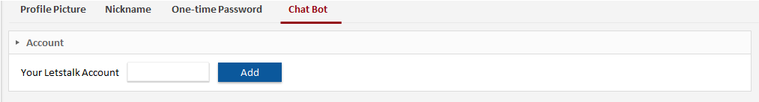
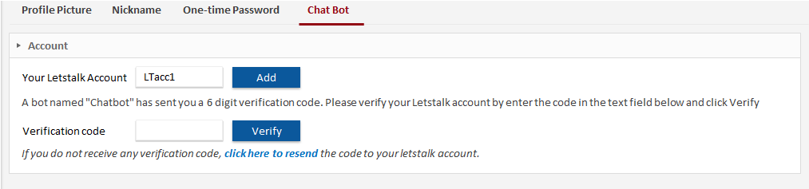

3. Mockups - Function Behaviors
Step #1: Chat Bot page opened
Step #2: Letstalk account added

Slide 6
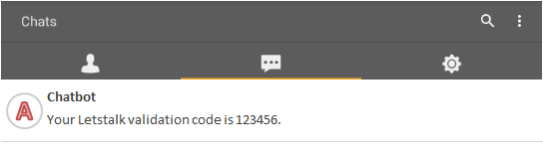
3. Mockups - Function Behaviors
Step #3: Chatbot contacts via Letstalk

Slide 7
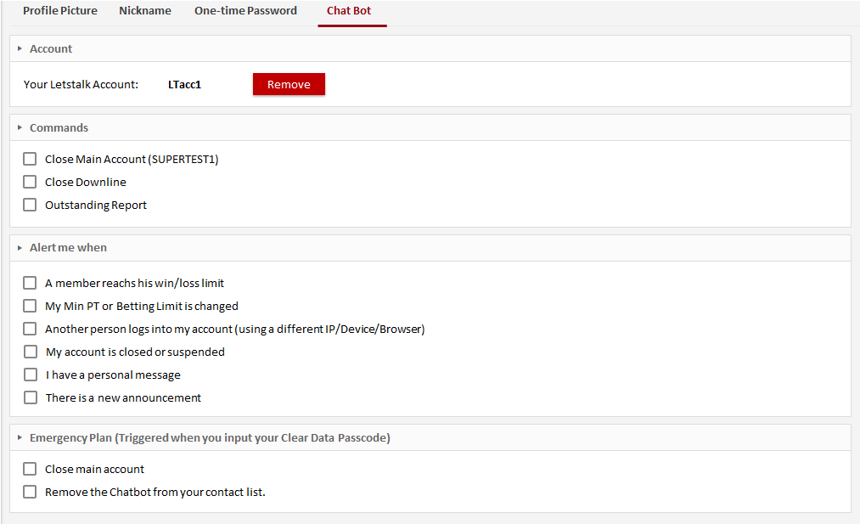
3. Mockups - Function Behaviors
Step #4: Validation code verified

Slide 8
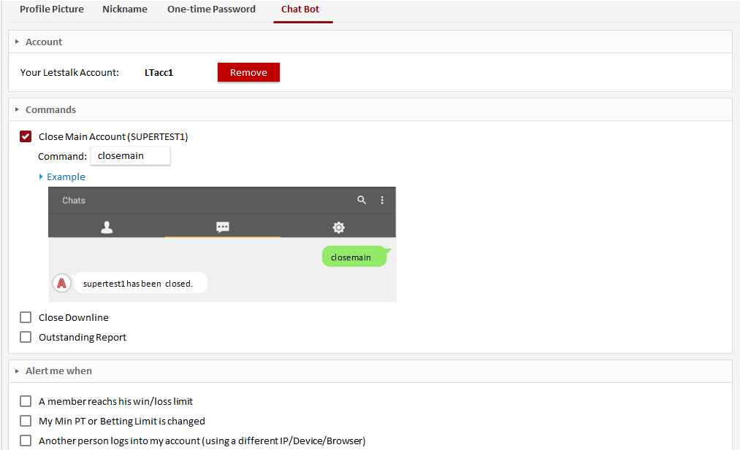




3. Mockups - Function Behaviors
Step #5: Content expanded after checking a checkbox.

Slide 9
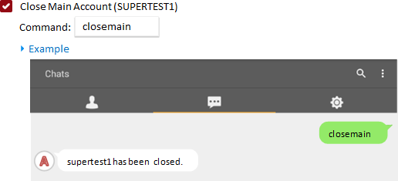
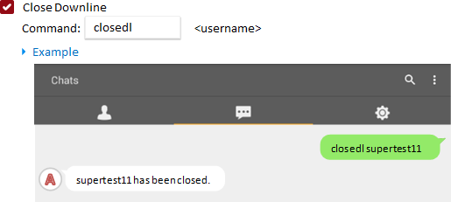
3. Mockups – Content Details - Commands

Slide 10
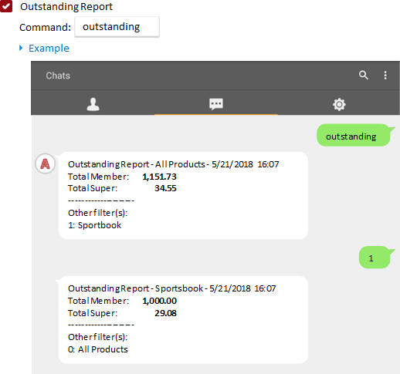
3. Mockups – Content Details - Commands

Slide 11
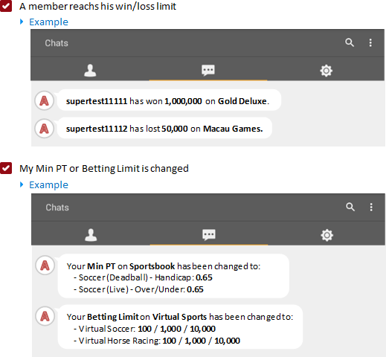
3. Mockups – Content Details - Alert

Slide 12
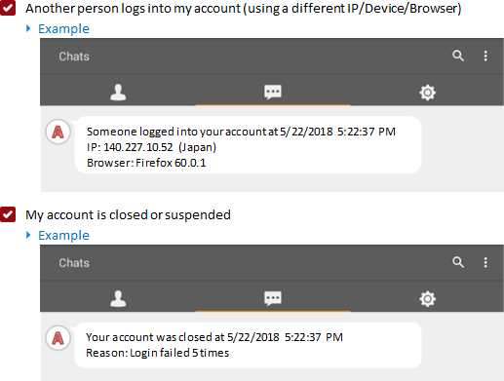
3. Mockups – Content Details - Alert

Slide 13
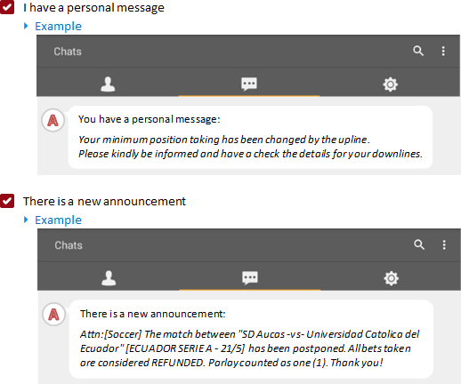
3. Mockups – Content Details - Alert

Slide 14
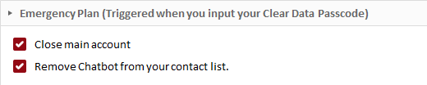
3. Mockups – Content Details – Emergency Plan

